Slide 1



Unlocking Venice's Airbnb Potential: Insights for Real Estate Investors
Essenam Komlanvi
Notes:
"Hello, everyone. Welcome to my presentation on 'Unlocking Venice's Airbnb Potential: Insights for Real Estate Investors.' My name is Essenam. Today, I’ll be sharing insights from my project on understanding the factors that drive successful Airbnb listings in Venice."

Slide 2







Introduction
Notes:
Venice is a prime location for Airbnb investments. However, maximizing returns requires understanding what drives high ratings. High ratings increase visibility, build trust, command higher prices, and enhance guest experiences. This dashboard aims to uncover these key factors.

Slide 3




Problem Statement
Understanding key factors for higher ratings in Venice
Notes:
"The problem we address is identifying the aspects of Airbnb listings that contribute to higher guest ratings. High ratings are crucial and our goal is to provide actionable insights for investors.

Slide 4

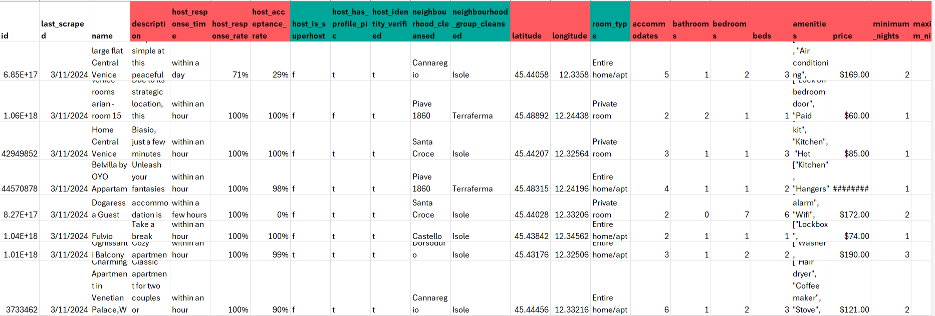
Overview of the data
Notes:
We used data from the Airbnb Open Data website, scraped in March 2024. Initially, the dataset included 8000 listings and 75 variables. We have quantitative variables like price and review score, and qualitative variables like property type and superhost status.

Slide 5

Data Cleaning and Preparation
Notes:
Data cleaning involved handling missing values, correcting errors, ensuring consistency, normalizing data, detecting outliers, and preparing the data for analysis. After cleaning, the dataset was refined to 2268 listings and 37 variables.

Slide 6
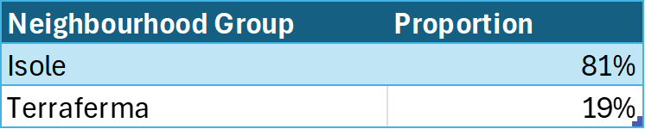
Descriptive Statistics
Notes:
This slide shows key statistics of Airbnb listings in Venice.
Host response and acceptance rates average 99%., Listings typically accommodate 4 guests with 1 bathroom and 1 bedroom. Average price per night is $139. Listings have an average review score of 4.79.
81% of listings are in Isole. 41% of listings are managed by superhosts. 77% are entire homes or apartments. 62% of listings are instant bookable.
These insights help investors understand the performance and characteristics of Airbnb listings in Venice.

Slide 7
Regression Model Insights
Notes:
The regression model shows that being a superhost has the most significant positive impact on ratings, with a coefficient of 0.21. Other important factors include the number of amenities and bedrooms. The model explains 43.3% of the variance in ratings.

Slide 8
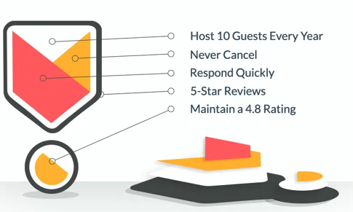


Key Insights
Notes:
Critical insights include the importance of superhost status, optimizing amenities, and targeting high-performing subregions like Isole. These strategies help Airbnb hosts and investors improve their listings and achieve better outcomes.

Slide 9
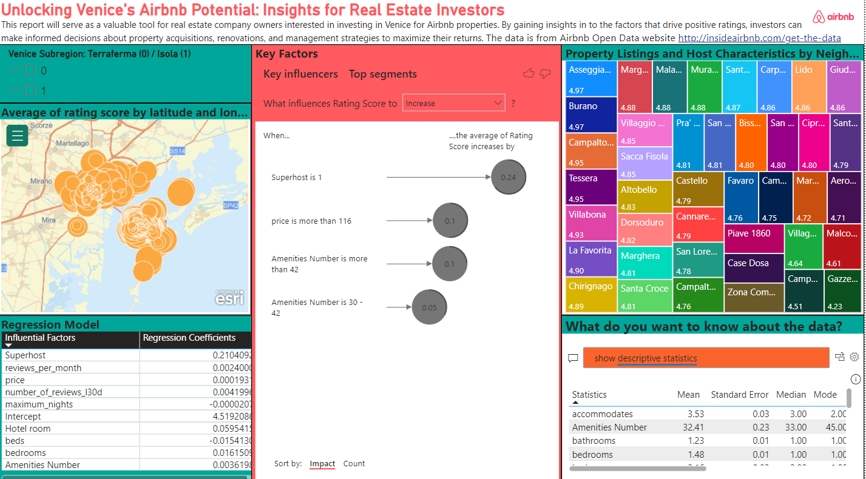
Dashboard
Notes:
The dashboard includes sections on location-based insights, subregion performance, descriptive statistics, a regression model, and key factors influencing ratings. Each section helps investors optimize their Airbnb listings.

Slide 10
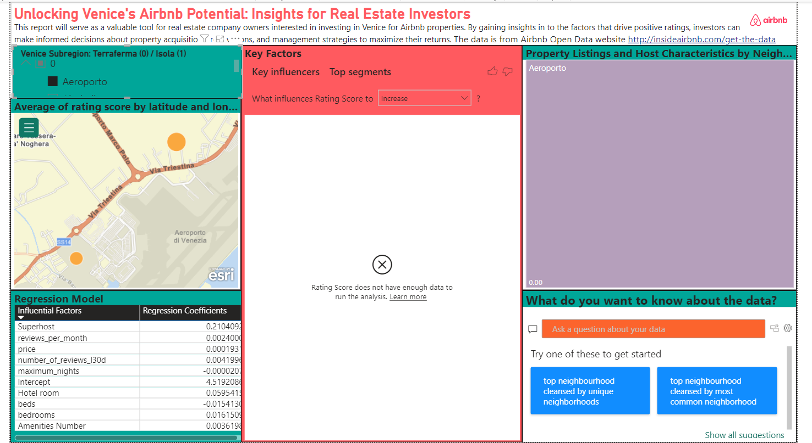

Scenario illustration 1
Notes:
An investor can use the dashboard to filter by criteria such as location and price range to find high-potential areas. For example, properties in Isole with certain amenities tend to receive higher ratings, guiding investment decisions.

Slide 11
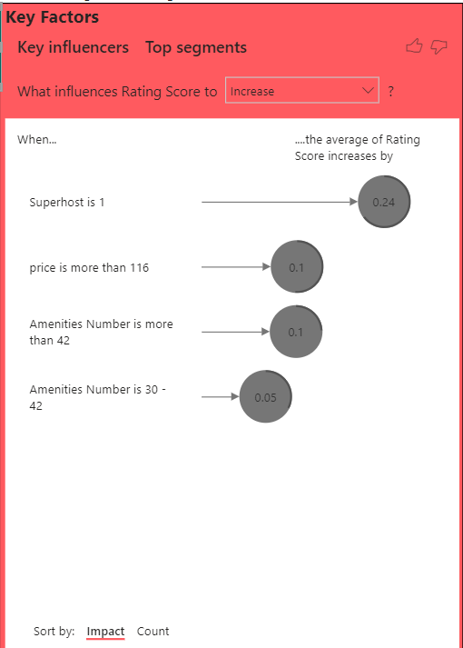
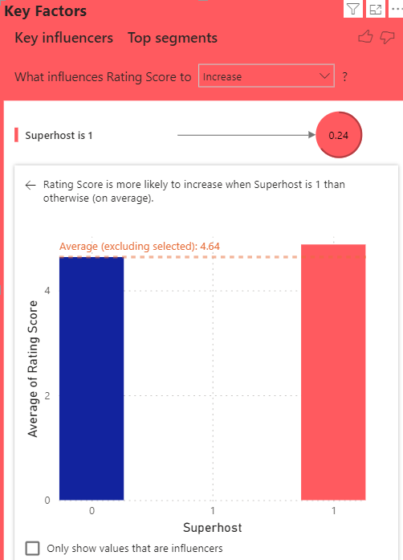
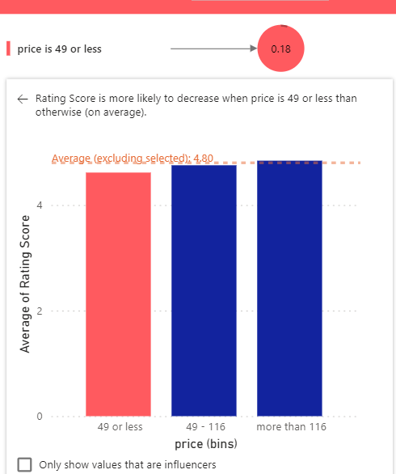
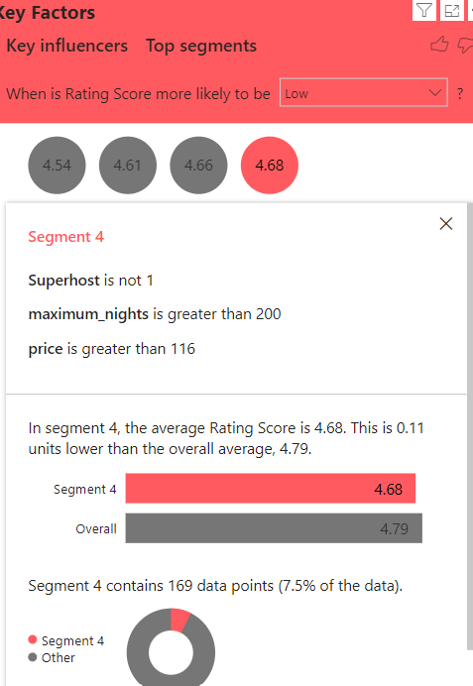
Scenario illustration 2
Notes:
The dashboard helps investors identify areas and property types that yield high ratings. An interactive chart shows how factors like superhost status and amenities influence ratings, aiding in data-driven investment decisions.

Slide 12
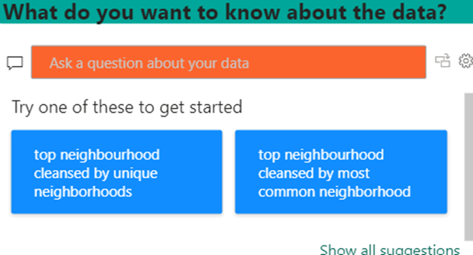
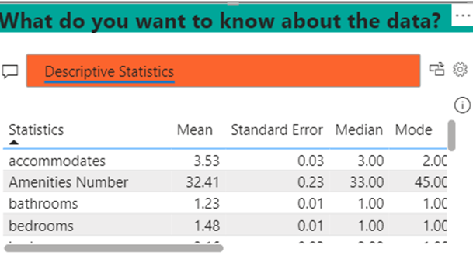
Scenario Illustration 3
Notes:
The dashboard features interactive elements for asking questions, viewing descriptive statistics, and exploring neighborhoods. Investors can use these features to identify high-performing areas and make informed decisions.

Slide 13


Challenges, Limitations, and Future Work
Data Limitations
Geographic Focus
Temporal Scope
Longitudinal Studies
Comparative Analysis
Advanced Predictive Models
Notes:
Data limitations include missing or inaccurate entries. Findings are specific to Venice and may not apply elsewhere. The analysis is a snapshot in time, and market conditions may change.
Future improvements include longitudinal studies, comparative analysis with other tourist destinations, and developing advanced predictive models to enhance performance predictions.

Slide 14
Conclusion and Recommendations
Thank you for your attention
Notes:
In conclusion, this dashboard offers valuable insights for Airbnb investors in Venice. Recommendations include maintaining high acceptance and response rates to achieve superhost status, offering a comprehensive range of amenities, and prioritizing properties in Isole for higher demand and better review scores.
Thank you for your attention.

